Slide 1
Data Warehousing and Decision Support
Jianlin Feng
School of Software
SUN YAT-SEN UNIVERSITY
Notes:
1

Slide 2
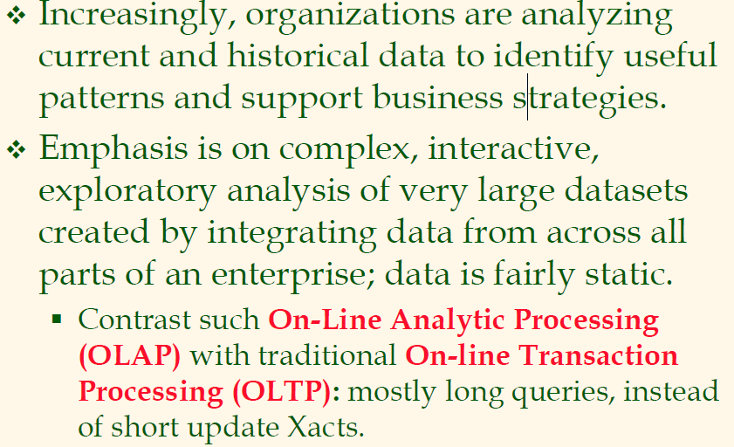
Introduction

Slide 3
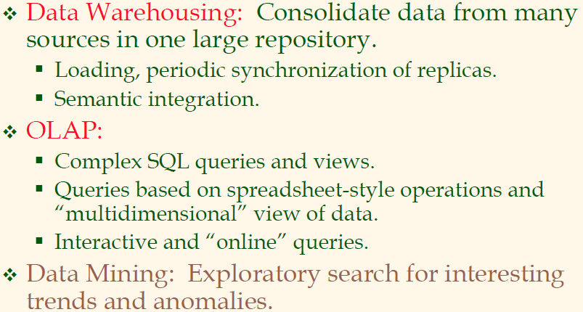
Three Complementary Trends

Slide 4
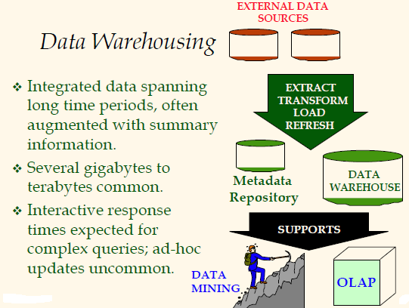

Slide 5
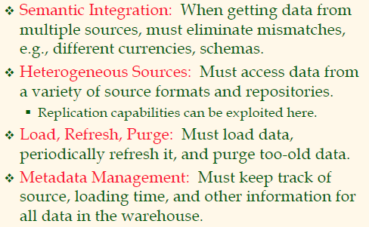
Warehousing Issues

Slide 6
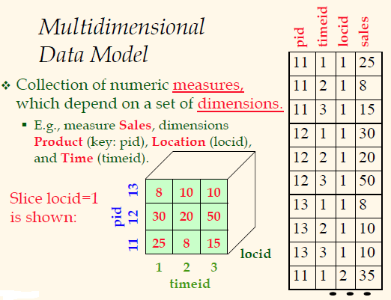

Slide 7
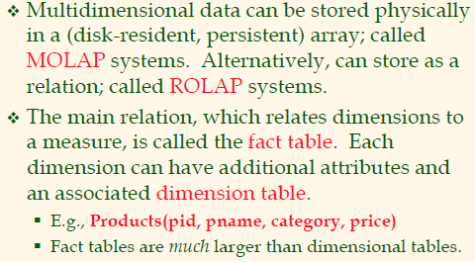
MOLAP vs. ROLAP

Slide 8
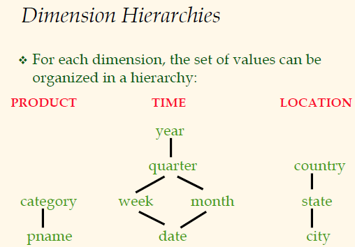

Slide 9
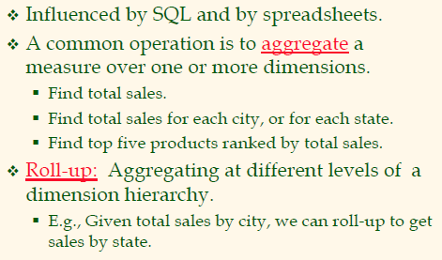
OLAP Queries

Slide 10
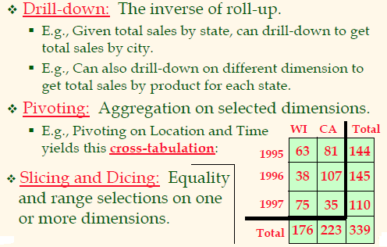
OLAP Queries (Contd.)

Slide 11
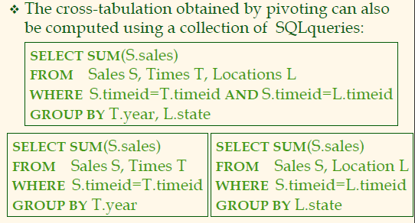
Comparison with SQL Queries

Slide 12
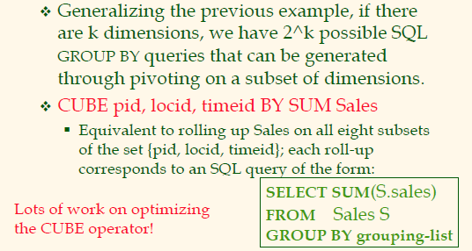
The CUBE Operator

Slide 13
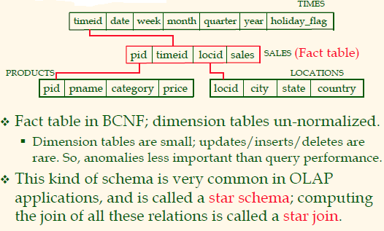
Design Issues

Slide 14
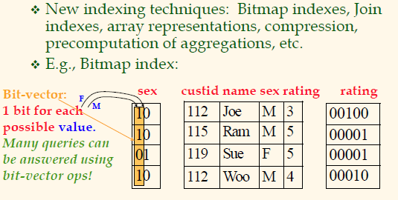
Implementation Issues

Slide 15
View Materialization
View Materialization means we physically pre-compute a view and use the materialized view to speed-up queries.
Pre-computation of a Data Cube is a special kind of view materialization.
Materialized views need maintenance.

Slide 16
Summary
Decision support is an emerging, rapidly growing subarea of databases.
Involves the creation of large, consolidated data repositories called data warehouses.
Warehouses exploited using sophisticated analysis techniques: complex SQL queries and OLAP “multidimensional”queries (influenced by both SQL and spreadsheets).
New techniques for database design, indexing, view maintenance, and interactive querying need to be supported.

